Slide 1
Intention Setting process
What do you desire?

Slide 2
Dear Beautiful Higher Self I am listening to what you really want to create and now calling upon you to flow your intentions through this pen. I trust and surrender the outcome will unfold in Divine Timing and I believe (with every cell in my body) that I am never given more than I can handle. In the spirit of magic, celebration and joy let us now commence this intention writing session and spark off that energy that will allow for the manifesting process to begin. With all my love to you. Signed……………………………………… Date…………………………………

Slide 3
You need to allocate some Time and Space. 30 minutes of uninterrupted time just for you.
Grab a pen and your favourite note pad or print out this document to fill in the worksheet.
You may even want a glass of wine, a hot soothing cup of tea, whatever your choice to relax, slow down and start to think about what you want.
Turn off any distractions and give yourself the time and space to be clear on your desires and your intentions.
Relax, have fun and lets start to create a life you love.

Slide 4
Meditate – Breath Within your quiet and relaxing environment, allow yourself to fully relax, loosening your jaw and your shoulders, allowing your body to become calm and open to receive. Focusing on your breathing, inhaling through the nose and out through the mouth, put on some soft soothing music to help you drift into a different more coherent state of surrender. Breath from your heart space, think about what you are already grateful for in your life.
Give yourself permission to receive all that you desire.
“I give myself permission to receive my desires, it is safe for me to receive abundance”

Slide 5
Journal - “What do I desire”?
Allow your imagination to be limitless, let it flow with your thoughts and remember to not restrict your desires or place any limits on your dreams.
If you start to put barriers up in your thinking – i.e. “that’s too big”, “that won’t happen” “I couldn’t do that” pause and breath more energy into the vision, removing any limits you are placing around it.
Don’t be self-conscious or hold yourself back from creating the life you desire.
Ask yourself “What do I desire”?
Try to eliminate the “how” from your thinking, just picture the “what” and “who”
Use your senses to help with your desires.
What would you like to see, to hear, to smell, to taste, to touch. Think about what your perfect day would look like for you?
(Imagine looking back on this in a years' time, everything has manifested – how would that feel, pretty fricking amazing! Give yourself permission to get inspired and use all your imagination).

Slide 6
What do I desire?
How would I feel when I manifested my desires? (freedom, happiness, safe, proud)
1
2
3
4
5
6
7
8
9
10

Slide 7
Be Do Have “You gotta be before you can do, and you’ve got to do before you can have” ~ Zig Ziglar.
Success in any area of life always starts with a very clear picture about the results you desire. If you don't know what the goal is, it is impossible to tell if you've achieved success or not.
Once we are really clear about what we want and why we want it, the game changing question in not ‘what do I need to do?’ but ‘who do I need to be?’
Another way of asking this question is ‘what kind of a person would have access to these kind of outcomes?’
Be Do Have
There are three common approaches to trying to get ahead in life. Only one of them actual works.
Let’s call them:
The Victim,
The Worker
The Winner
The victim arranges their life in the order HAVE DO BE
They say, “When I HAVE enough time, money and support, then I’ll DO the things I’ve always wanted to, and then I’ll BE happy and successful. The problem is I don’t HAVE yet. If I had what that person had, I’d certainly be as successful as them, but I don’t so I’m not.“ The victim is always waiting for externals to change before they can move ahead in life.
The worker is all about DO HAVE BE
They say, “The more I DO, the more I’ll HAVE. The more I’ll HAVE, the happier I’ll BE. The problem is, the more I do, the more there is still to do and the more I have to more there is still to have. I am defined by what I do so I become driven, busy and tired. The more I have, the more there is to lose so the harder I work.” We all know that the link between having more things and being happier is a myth, so being happy never arrives.
The winner orients their life quite differently: BE DO HAVE
They say, “It is not what do I need to HAVE before I can start, or what work do I need to DO… but who do I need to BE? What kind of person would have access to the kind of outcomes I want? Then being that kind of person, what would I be doing? And then the having takes care of itself.”
Be Do Have is definitely the rarest of the three lifestyles and the most abstract, yet it is the only one that works.

Slide 8
Who do you need to be? What kind of a person would have access to these kind of outcomes?
What kind of person has what I want?
What must they believe about themselves?
How do they dress?
What is their relationship with money?
What story do they live out of?
How do they walk when they enter a room?
What attributes do they bring to their daily life?
What values do they live by?

Slide 9
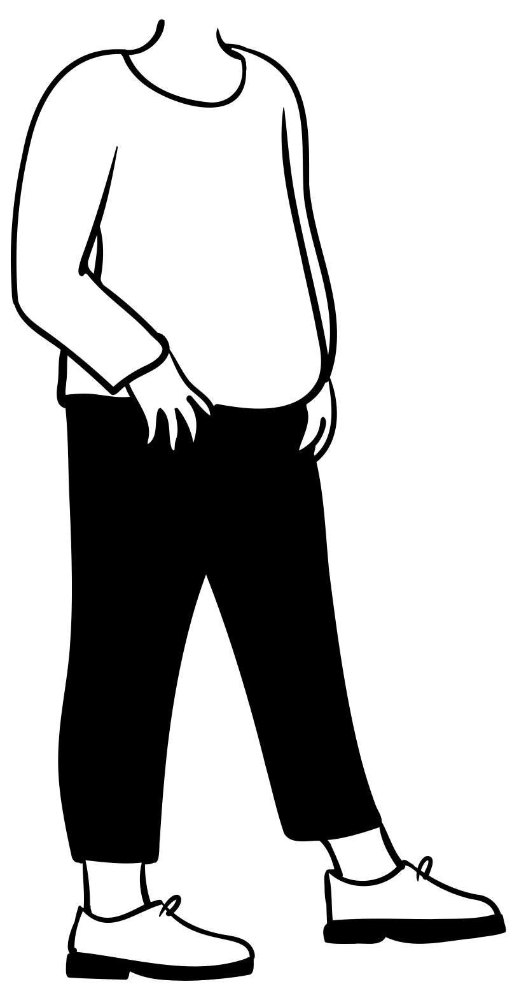
Name 3 people that you would like to be like, that inspire you, that you look up to for their attributes, values and accomplishments.

Slide 10
Lets say that you are a leading world expert on a certain topic, what is your title? For example ‘I am now the worlds leading manifesting expert’.

Slide 11
Write down the top 3 things you would like to be….(e.g. Bestselling author, celebrity chef, award winning producer)
1.
2.
3.
Picture yourself as this person – given everything you have thought about who you need to be, what you want and the list above, imagine yourself as that person. Focus on the feeling you would have when you become her/ him and how you would feel, bring all those emotions and feelings to the surface. You would be proud of yourself right!

Slide 12
Do you believe you could make these things happen in the next year? If yes, what are 3 steps you could take in the next few days to get the ball rolling in the direction – it doesn’t matter the size of the step, its still a step in the right direction.
1
2
3

Slide 13
‘Energy flows to where your focus goes’ Being present with your vision is important, spend time everyday sending energy to your vision. Being with that vision in the present moment, sending your focus, love and gratitude to that vision.
What 6 things that bring you the greatest sense of peace, presence and well-being?
NOW MAKE SURE YOU DO THEM DAILY.
1
2
3
4
5
6

Slide 14
What lights you up? What warms your heart, what ignites your soul? List everything….drawing, writing, singing, gardening etc

Slide 15
I want to be……

Slide 16
What do you want to do? Present that money is no object, there are no limitations. You have more money than you could ever spend. What would you do?

Slide 17
Would you still be in the business (or industry) youre in now if you didn’t have to make money? If so, why?
What do you do in life to serve others? Service is vital for the success of any business and the peace and growth of your soul.

Slide 18
What are the top 5 roles that you play in the world? E.g. Mother, Daughter, Friend, Lover etc
1
2
3
4
5

Slide 19
Name 6 places you would love to visit in the next year…..
1
2
3
4
5
6

Slide 20
What is one thing that no-one would ever guess that you really wanted to do? How can you make it happen?

Slide 21
What are 3 things that you would like to do and have accomplished 12 months from today? 1 2 3
Name 3 things/ resources/ tools that will help you do this and achieve your goal……
1
2
3

Slide 22
What do you want to have?
This is the fun part where you start to order from the cosmic catalogue! Setting very clear intentions about what you want to create is super important.
What type of a house do you want to live in? Be very specific. The universe is listening……

Slide 23
What kind of car do you want to drive?
What does your body look like, and what is your fitness level? How do you feel?

Slide 24
£500,000 is gifted to you randomly and you have to pay it forward, who would you give it to and why? And how do you think this would make you feel?

Slide 25
Design your ultimate wish-list with 12 things you would LOVE to manifest…..
1
2
3
4
5
6
7
8
9
10

Slide 26
Last step – Seal it up, put it away somewhere safe and then set a reminder to revisit it. Take with you what you need to as in next steps towards your desires and the practises for visualisation etc. Revisit your list whenever you need that surge of motivation and inspiration. The key is to TRUST & SURRENDER

