Slide 1
VALUES

Slide 2
VALUES
Principles or standards of behavior; one's judgement of what is important in life.
Your values are the things that you believe are important in the way you live and work. They (should) determine your priorities, and, deep down, they're probably the measures you use to tell if your life is turning out the way you want it to.

Slide 3
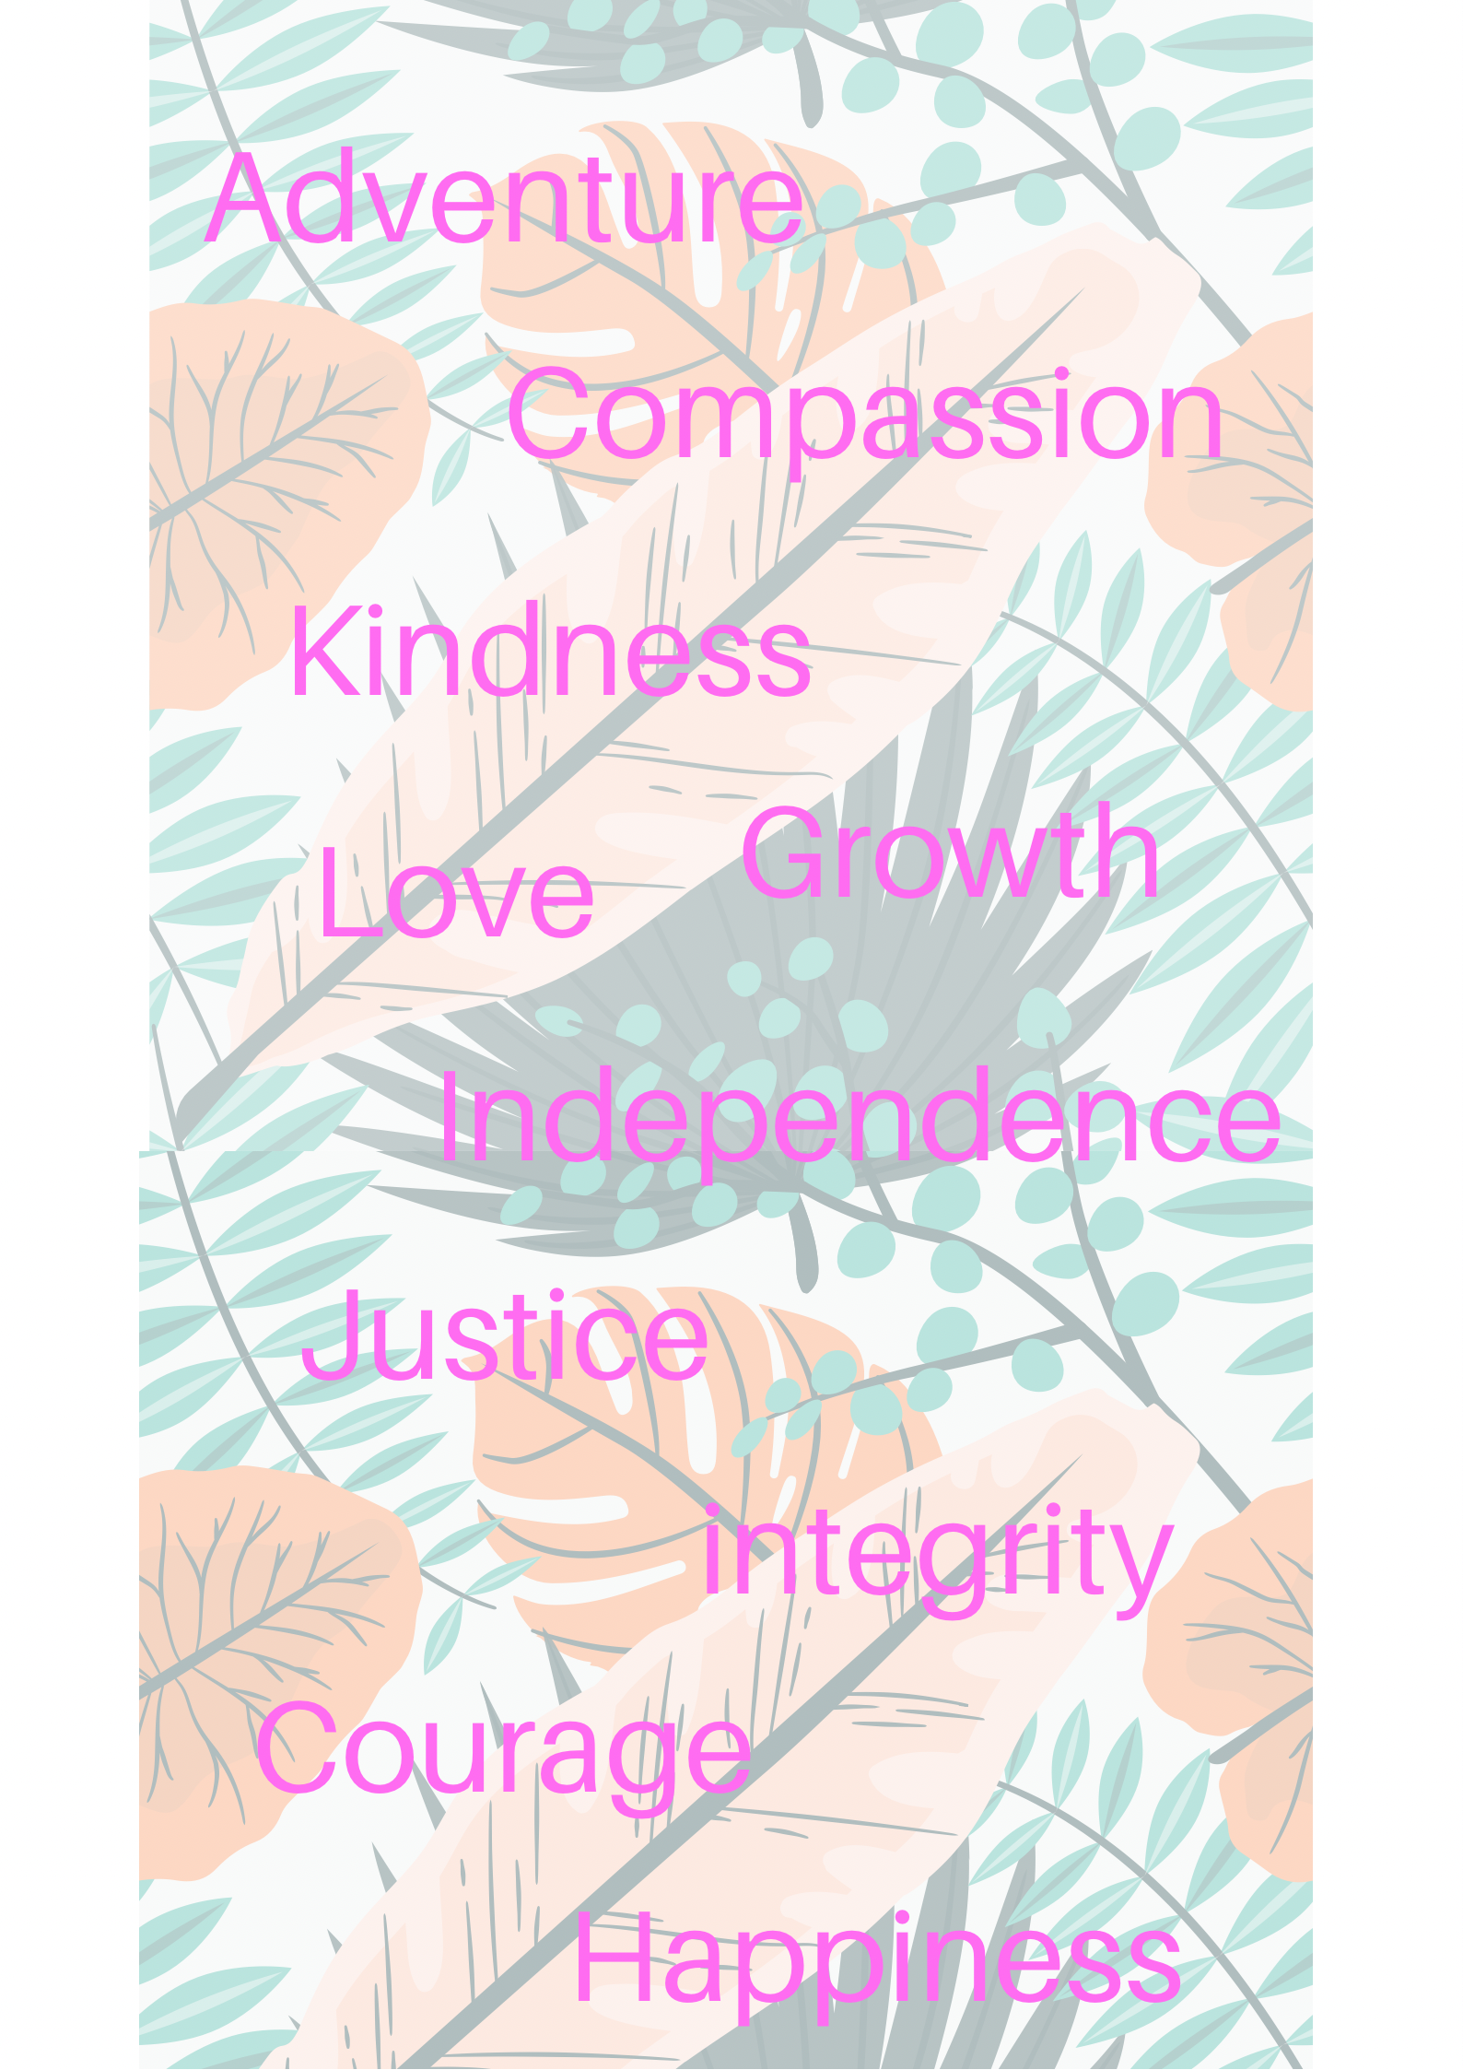
MY VALUES

Slide 4
Authenticity
Achievement
Adventure
Authority
Autonomy
Balance
Beauty
Boldness
Compassion
Challenge
Citizenship
Community
Competency
Contribution
Creativity
Curiosity
Determination
Fairness
Faith
Fame
Friendships
Fun
Growth
Happiness
Honesty
Humour
Influence
Inner Harmony
Justice
Kindness
Knowledge
VALUES
List of Personal Values

Slide 5
Leadership
Learning
Love
Loyalty
Meaningful Work
Openness
Optimism
Peace
Pleasure
Poise
Popularity
Recognition
Religion
Reputation
Respect
Responsibility
Security
Self-Respect
Service
Spirituality
Stability
Success
Status
Trustworthiness
Wealth
Wisdom
VALUES
List of Personal Values

Slide 6
What's important to you in life?
If you could have any career, without worrying about money or other practical constraints, what would you do?
When you’re reading news stories, what sort of story or behaviour tends to inspire you?
What type of story or behaviour makes you angry?
What do you want to change about the world or about yourself?
What are you most proud of?
When were you the happiest?
VALUES
Brainstorm exercise
.

Slide 7
NOTES
VALUES
Brainstorm exercise
.

Slide 8
Values can, be ‘changed’ in the sense that many of us lead our lives from values that aren’t even ours, instead they are ‘borrowed’ from people around us – parents, peers, or partners.
So, we can identify this problem and ‘change’ to our own values that suit us better.
Our values evolve as we do;
For example, if you have the value of success, that might look like ambition when you are young. When you are older, that same value might attach to a sense of learned compassion and become justice – success not just for yourself, but for others
In some cases, values will be easy to figure out. If you wrote “a loving relationship” in response to the question about what’s important to you, then “love” is an important personal value for you. If you wrote “being happy,” then you value happiness.
VALUES

Slide 9
Our deep personal values, are the best way for us to align ourselves with a life that leaves us peaceful and purposeful.
Internal issues can arise in everyday situations when we are living outside our values.
What they can cause us?
They cause us to feel uneasy or unbalanced about a situation at work, at home, in our friendship groups, meeting a person we do not “gel” with but don’t know why.
It could be the environment we live in, the environment that we work in. Our family dynamics.
They can cause emotions – example - Anger: The purpose of anger is to assert boundaries and protect ourselves from harm, as well as to motivate us to take action when we feel that our needs or values have been violated.
The purpose of guilt is to signal that we have violated our own moral code of values.
Your values act as your “north star” guiding you back to your true self and what is important to you.
VALUES

Slide 10
And yet so many of us don’t consistently live by our values. Have you ever been in any of these situations?
Someone said or did something that you strongly disagreed with, but you didn’t speak up about it and felt ashamed afterwards.
You set goals for yourself and then failed to meet them.
Your life or career haven’t worked out the way you wanted them to.
What you want often clashes with what you've got to do or what’s “practical.”
You’re so busy pleasing other people that you’re not even sure what your own true values are.
If any of these resonate with you, then this tutorial will help you. In it, you’ll learn what personal values are and why they’re important. Then we’ll go through all the steps involved in defining and prioritising your values, changing them as necessary, and living by them so that your actions are aligned with your values.
When you live by your values, you feel better about yourself and are more focused on doing the things that are important to you. In this tutorial, you’ll see how to achieve that.
VALUES

Slide 11
NOTES
VALUES

Slide 12
VALUE
SCORE
TOTAL
VALUES
HAPPINESS
6
LOVE
4
COMPASSION
3
KINDNESS
INDEPENDENCE
JUSTICE
INTEGRITY
HONESTY
COURAGE
PEACE

Slide 13
You've got many techniques available to you to help you change your reactions and live more consciously in accordance with your values.
For example, you could:
Make a habit of reading your list of values every morning when you wake up.
Visualise the day ahead and plan out how you'll live by your values throughout the day.
Print out your values and keep them close to you to refer to through the day.
Make them the background on your mobile phone or computer.
Check in with yourself when a situation arises that makes you feel out of alignment and check where you are not living within your values.
VALUES

Slide 14
There are 3 main questions that I will answer in my check in or again, if a situation arises where I feel I need to check in with myself and my values.
What are the core values that drive my life and work?
2. How am I living and working with integrity right now?
3. How can I set a higher standard in the future?
VALUES

